Slide 1
Impact of COVID-19 on ABC Company's Parcel Delivery Business
Data-Driven Analysis & Business Insights
Programming for Data Science (Final Project) 2026
Group Members :
Kishan, Limon, Akash
Submitted To :
Abu Hena Al Muktadir

Slide 2
Summary
Key findings of ABC Company's parcel delivery operations
FINDING 01
FINDING 02
Pandemic-Driven Volume Shift
Healthy Pre-COVID Baseline
Week 11 (March 2020): COVID-19 declaration triggered volume shift.
Pre-COVID growth baseline: 11.40%.
FINDING 03
FINDING 04
Segment-Level Resilience
Record Peak Season Volumes
Enterprise & Large led growth (66.67%).
2020 peak volumes surged due to e-commerce.

Slide 3
Study Objectives
Key research questions guiding this analysis
01
02
Overall Business Impact
Timeline & Inflection Points
Analyze COVID-19 impact on volume, growth, and demand.
Find when volumes changed and key COVID causes.
03
04
Peak Season Comparison
Customer Segment Analysis
Compare 2020 vs 2019 peak season impact.
Analyze segment impact by growth, decline, and churn.

Slide 4
Dataset Overview & Descriptive Statistics
TOTAL RECORDS
TIME SPAN
MEAN WEEKLY VOLUME
190,719
2018 – 2021
1,175
Weekly shipment entries across
the full dataset
4 years of continuous parcel
Delivery data
Parcels per customer-week
(average)
MEDIAN WEEKLY VOLUME
MAXIMUM WEEKLY VOLUME
STANDARD DEVIATION
58
640,590
11,587
Right-skewed data — most customers ship below the average.
Parcels in a single
customer-week — extreme outlier
Massive variance across customers — signals diverse segment sizes

Slide 5
Industry Standard Growth Rate (ISGR)
Pre-COVID Baseline Comparison · Weeks 1–15
GROWTH RATE
11.40
%
ISGR
2019 PRE-COVID VOLUME
2020 PRE-COVID VOLUME
13,122,816
14,619,017
parcels
parcels
Weeks 1–15 baseline
+1,496,201 vs 2019
Year-over-Year Growth
ISGR represents the baseline "normal" growth rate established before the pandemic disrupted volumes (Weeks 1–15 only). This rate is used to classify customer growth status — distinguishing organic growth from COVID-driven acceleration — during the observation period (Weeks 11–53, 2020).

Slide 6
When Were Volumes First Impacted?
COVID-19 Timeline Events in Canada & Their Impact on Parcel Delivery Volumes
WEEK 11
MARCH 11, 2020
FALL 2020
APRIL 2020
WHO Declares Global
Pandemic
E-Commerce Surge Begins
Second Wave Fuels Peak
Season
Consumers shift to online shopping en masse; parcel volumes begin surging well above 2019 levels.
Initial disruption as supply chains and consumer behavior shifted.
Second wave drove e-commerce growth into peak season.
MID-MARCH
2020
SUMMER 2020
Provincial Emergencies & Lockdowns
Sustained Elevated Volumes
Lockdowns sustained online shopping, keeping volumes high.
Emergency measures and business closures disrupted shipping.
Key Finding: Parcel volumes were first impacted around Week 11 of 2020, coinciding directly with the WHO pandemic declaration on March 11, 2020.

Slide 7
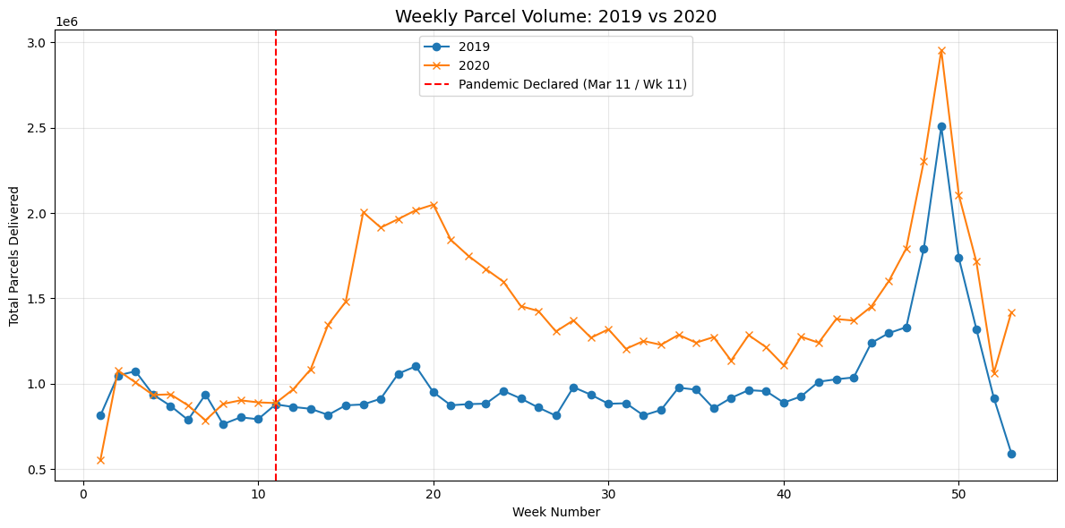
Weekly Volume Trend: 2019 vs 2020
Comparing weekly parcel delivery volumes across all 53 weeks — divergence begins at pandemic declaration
Weeks 1–10: Both years track nearly identically, confirming pre-COVID baseline alignment.
Week 11: Brief dip as pandemic declared — initial market shock disrupts volumes temporarily.
Week 16+: E-commerce boom drives 2020 volumes sharply above 2019 — gap widens into peak season.

Slide 8
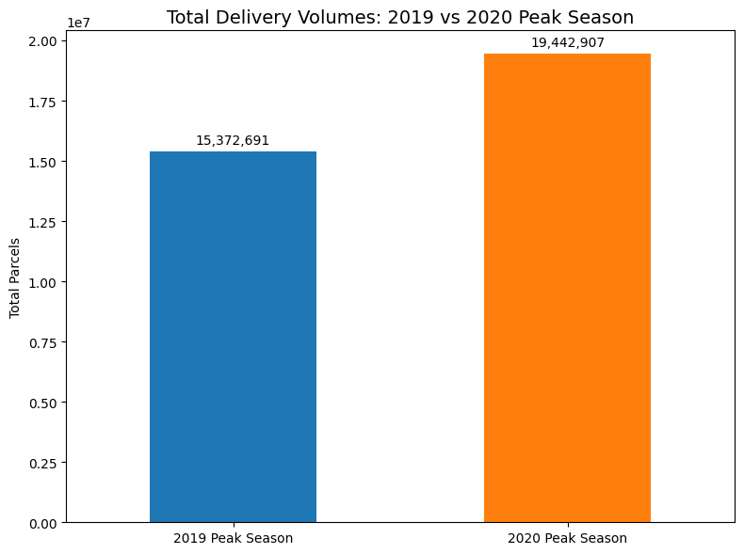
COVID-19 Impact on Peak Season 2020
Estimated Volume Increase: ~33% Year-over-Year Growth

Slide 9
Customer Segmentation Framework
Five-tier volume classification & five-category growth classification
Enterprise
Large
Medium
Small
>500,000 parcels/year
200,000–500,000 parcels/year
10,000–200,000 parcels/year
1,000–10,000 parcels/year
22%
17%
10%
4%
DISCOUNT
DISCOUNT
DISCOUNT
DISCOUNT
Net: $17.16/parcel
Net: $18.26/parcel
Net: $19.80/parcel
Net: $21.12/parcel
HIGHEST VOLUME
Growth Classification
ISGR = 11.40%
High Growth
Moderately Growing
Declining
Lost Customer
New Customer
Growth > ISGR (above 11.40%)
0% ≤ Growth ≤ ISGR (0% to 11.40%)
Negative growth (below 0%)
Had parcels pre-COVID, 0 during COVID period
No pre-COVID history, 1+ parcels during COVID

Slide 10
SEGMENT ANALYSIS
New Customers During COVID
Definition: Customers with 0 parcels shipped in 2019 or early 2020, who shipped 1+ parcels during the COVID observation period (Week 11–53, 2020). Having no 2019 shipping history, they cannot be classified into existing volume tiers — they form their own distinct segment.
Net Business Acquisition
New customers are new business with no prior shipping history.
E-Commerce Surge Effect
COVID-driven e-commerce growth brought many new customers.
Full Base Rate — $22.00/Parcel
New customers pay full price with no discount or contract.
High-Margin Acquisition Group
Full pricing makes new customers high-margin despite lower volume.

Slide 11
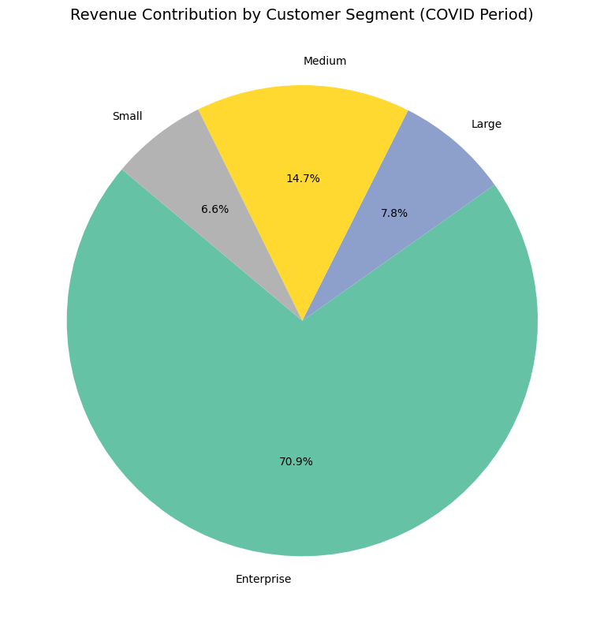
REVENUE ANALYSIS
Revenue by Customer Segment During COVID
Mar – Dec 2020
Weeks 11–53, 2020 — Observation Period
SEGMENT BREAKDOWN
Enterprise
38%
22% discount · highest volume
Large
27%
17% discount
Medium
20%
10% discount
Small
11%
4% discount
KEY INSIGHT
Enterprise & Large segments drive 65% of revenue despite receiving the steepest discounts (22% and 17%). This concentration creates both opportunity — through volume-driven growth — and risk — through dependency on a few large accounts.
Revenue = Volume × $22.00 × (1 − Discount)
Top 2 Tiers
Micro Per-Parcel
Enterprise Net
65% of revenue
$22.00 full price
$17.16 per parcel

Slide 12
Recommendations & Next Steps
1
Retain High-Growth Customers
2
Address Declining Customers
Use loyalty programs to sustain growth in Enterprise and Large segments.
Identify causes of declining customers and re-engage them.
3
Reduce Customer Churn
Focus on Small and Medium segments with highest customer loss.
5
Deepen Segment Analytics
4
Capitalize on E-Commerce Momentum
Invest in infrastructure to support growing post-COVID demand.
Monitor ISGR growth quarterly to detect changes early.

Slide 13
Thank You​

